Slide 1
RANDOM FOREST FOR CREDIT CARD FRAUD DETECTION

Slide 2
ABSTRACT
Credit card fraud events take place frequently and then result in huge financial losses.
Criminals can use some technologies such as Trojan or Phishing to steal the information of other people’s credit cards. Therefore, an effective fraud detection method is important since it can identify a fraud in time when a criminal uses a stolen card to consume.
One method is to make full use of the historical transaction data including normal transactions and fraud ones to obtain normal/fraud behavior--

Slide 3
--features based on machine learning techniques, and then utilize these features to check if a transaction is fraud or not.
In this paper, Random Forest is used to train the behavior features of normal and abnormal transactions. We analyze the performance on credit fraud detection. The data used in our experiments come from an e-commerce company in China.

Slide 4
INTRODUCTION
Credit cards are widely used due to the popularization of ecommerce and the development of mobile intelligent devices.
Credit card has made an online transaction easier and more convenient. However, there is a growing trend of transaction frauds resulting in a great losses of money every year.
It is estimated that losses are increased yearly at double digit rates by 2020. Since the physical card is not needed in the online transaction environment and the card’s information is enough to complete a payment, it is easier to conduct a fraud than before.

Slide 5
Transaction fraud has become a top barrier to the development of e-commerce and has a dramatic influence on the economy. Hence, fraud detection is essential and necessary.
Fraud detection is a process of monitoring the transaction behavior of a cardholder in order to detect whether an incoming transaction is done by the cardholder or others.
Generally, there are two kinds of methods for fraud detection: misuse detection and anomaly detection. Misuse detection uses classification methods to determine whether an incoming transaction is fraud or not. Usually, such an approach has to know about the existing types of fraud to make models by learning the various fraud patterns.

Slide 6
Anomaly detection is to build the profile of normal transaction behavior of a cardholder based on his/her historical transaction data, and decide a newly transaction as a potential fraud if it deviates from the normal transaction behavior.
However, an anomaly detection method needs enough successive sample data to characterize the normal transaction behavior of a cardholder.
This paper is about misuse method. We use random forest to train the normal and fraud behavior features. Random forest is a classification algorithm based on the votes of all base classifiers.

Slide 7
The major contributions of this paper are summarized as follows.
1) To deal with normal/fraud detection problem, the Random Forest algorithm is used to train the normal/fraud behavior features.
2) From the result of experiments, some conclusions are made which would be helpful for future work.

Slide 8
LITERATURE SURVEY
A New Framework for Credit Card Transactions Involving Mutual Authentication between Cardholder and Merchant
Electronic Commerce (e-Commerce) and ease in the onsite transactions have led to the exponential growth in the acceptance of credit cards among consumers of all the sections. In this paper, we discuss and analyze the current developments in online authentication procedures including biometrics, one-time-password systems and use of mobile device and Public Switched Telephone Network for cardholder authentication. Then we propose a complete new framework for both onsite and online (Internet shopping) credit card transactions. This framework is more secure, robust, enhances user privacy and does not involve the deployment of special hardware systems at the customer's site.

Slide 9
2. Random forest for credit card fraud detection
Credit card fraud events take place frequently and then result in huge financial losses. Criminals can use some technologies such as Trojan or Phishing to steal the information of other people's credit cards. In this paper, two kinds of random forests are used to train the behavior features of normal and abnormal transactions. We make a comparison of the two random forests which are different in their base classifiers, and analyze their performance on credit fraud detection. The data used in our experiments come from an e-commerce company in China.

Slide 10
3.Unsupervised Profiling Methods for Fraud Detection (2001)
Credit card fraud falls broadly into two categories: behavioural fraud and application fraud. Application fraud occurs when individuals obtain new credit cards from issuing companies using false personal information and then spend as much as possible in a short space of time. We discuss two methods for unsupervised fraud detection in credit data in this paper and apply them to some real data sets. Peer group analysis is a new tool for monitoring behaviour over time in data mining situations. In particular, the tool detects individual accounts that begin to behave in a way distinct from accounts to which they had previously been similar. Each account is selected as a target account and is compared with all other accounts in the database, using either external comparison criteria.

Slide 11
EXHISTING SYSTEM
Credit cards are widely used due to the popularization of ecommerce and the development of mobile intelligent devices. Card-not-present transactions (i.e., online transaction without a physical card) are more popular, especially all credit card operations are performed by web payment gateways, e.g., PayPal and Alipay. Credit card has made an online transaction easier and more convenient. However, there is a growing trend of transaction frauds resulting in great losses of money every year.
Disadvantage:
The main disadvantage of the existing system is the detection occurs only after gets a written complaint.

Slide 12
PROBLEM STATEMENT
Credit card fraud detection is challenging task for the users online payment does not require physical card. And if anyone who knows the details of card can make the transactions currently, card holder comes to know only after the fraud transaction is carried out to proper mechanism are there to track the fraud transaction.

Slide 13
OBJECTIVES
The aim of the project is to find out the normal transactions and fraud ones based on machine learning techniques, and then utilize these features to check if a transaction is fraud or not.

Slide 14
PROPOSED SYSTEM
In proposed system, we use misuse method which can ask the computer to find out whether it’s credit card fraud or not. In this story, we used Random Forest algorithm that analyzes and predicts the fraud and non-fraud/valid transactions.
Advantages:
Performance is good.
Reduces the time required to predict the output.
Used for real time predictions of fraud transactions.

Slide 15
HARDWARE & SOFTWARE REQUIRMENT
H/W System Configuration:-
Processor : Dual Core
Speed : 1.1 G Hz
RAM : 4 GB (min)
Hard Disk : 20 GB
Key Board : Standard Windows Keyboard
Mouse : Two or Three Button Mouse
Monitor : SVGA

Slide 16
S/W System Configuration:-
Operating System : Windows XP,7,8,10
Technology : Python
Front End : Tkinter
IDLE : Python 2.7 or 3.7
Database : MySQL

Slide 17
METHODOLOGY
List of Algorithms:
KNN
SVM
Random Forest
Naïve Bays
List of Modules:
Registration Module
Login Module
Prediction Module

Slide 18
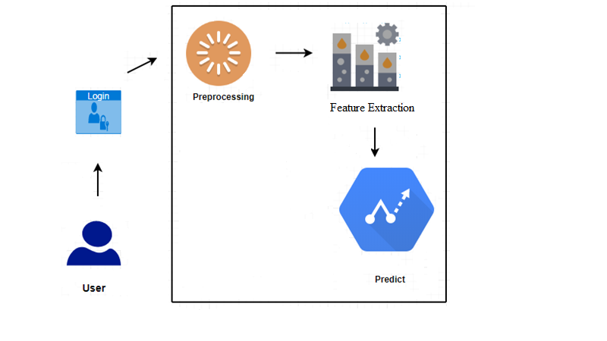
SYSTEM ARCHITECTURE

Slide 19
CONCLUSION
This paper has examined the performance of Random Forest model. A real-life B2C dataset on credit card transactions is used in our experiment. Although Random Forest obtains good results on small set data, there are still some problems such as imbalanced data. Our future work will focus on solving these problems. The algorithm of random forest itself should be improved. For example, the voting mechanism assumes that each of base classifiers has equal weight, but some of them may be more important than others. Therefore, we also try to make some improvement for this algorithm.

Slide 20
Thank you

